Slide 1
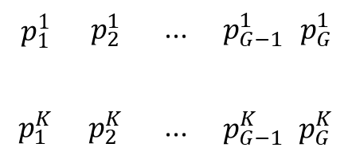
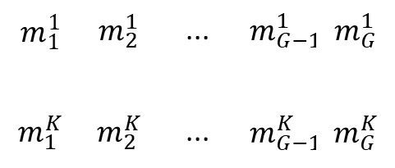


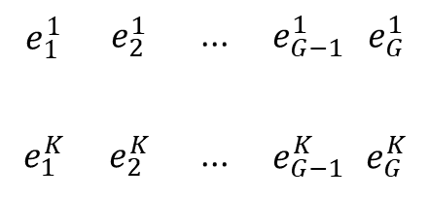
M
P
E
$$m_{1}^{1}$$ | $$m_{2}^{1}$$ | ... | $$m_{G−1}^{1}$$ | $$m_{G}^{1}$$
$$m_{1}^{K}$$ | $$m_{2}^{K}$$ | ... | $$m_{G−1}^{K}$$ | $$m_{G}^{K}$$
$$p_{1}^{1}$$ | $$p_{2}^{1}$$ | ... | $$p_{G−1}^{1}$$ | $$p_{G}^{1}$$
$$p_{1}^{K}$$ | $$p_{2}^{K}$$ | ... | $$p_{G−1}^{K}$$ | $$p_{G}^{K}$$
$$e_{1}^{1}$$ | $$e_{2}^{1}$$ | ... | $$e_{G−1}^{1}$$ | $$e_{G}^{1}$$
$$e_{1}^{K}$$ | $$e_{2}^{K}$$ | ... | $$e_{G−1}^{K}$$ | $$e_{G}^{K}$$
. . .
$$≈$$
. . .
$$×$$
. . .
...
...
...
...
...
...
...
...
...
...
...
...
Mutational catalog of cancer genomes
KNOWN
Genome (G)
Number of SNVs
in each context (K)
Mutational probabilities
KNOWN
Mutation and context (K)
UNKNOWN
Signature (G)
Exposure of mutational processes (%)
UNKNOWN
Signature (K)
Genome (G)

